Slide 1
Advocates 2019 Professionallyintegrated.com
Dr. Evan Katz DC

Slide 2
https://professionallyintegrated.com/

Slide 3
Two “sides” of PI
“Mills”. Playing the “game”
Relationships over patient care
Concerned with colossus
Keep bills low
Simple diagnosis (whiplash,pain sprain/strain, disc)
Research and guidelines thrown away
Practice management
Average case worth $3000 and you get asked to take money off
Just the “Business” of PI
High Quality, patient and science first
Patients first
Concerned with the research
Bill appropriately
Appropriate diagnosis and validated treatment
Research,gudelines, and clinical experience put forth
Patient management
Average case worth $10,000-$18,000 and you get a call saying “thanks”
Realizing being an expert in the community is the best “business”

Slide 4
What does it mean to YOU, to say you do “PI”?
You are an expert in “colossus”, certain guidelines, and you know what amount attorneys do not want you to bill over and you know how much to “cut”?
OR, are you an expert in the science and research on the complexities of injuries that can occur in trauma and the treatment needed?

Slide 5
Long-Term Outcomes Of Individuals Injured In A Motor vehicle Crash. A Population Based Study
Over 30,000 participants were followed for two years
About 600 were in a car crash
Population was given Euroqol Health Index (EQ-5D)
Conclusion: Traffic Injuries are SIGNIFICANTLY associated with LONG TERM REDUCED HRQOL. Injured individuals may benefit from early intervention programs to prevent the development of secondary complications and reduced HRQOL
Injury 2015
I ask YOU, WHY are so many patients chronic? We will go over it at ATMI.

Slide 6
Terminology
“Whiplash” is not a diagnosis, it is a mechanism of injury
“soft-tissue” injury is non-specific
“Pain” is not a diagnosis. What is pain from?
It is a “crash”, not an “accident”

Slide 7
AMTI will get specific. Not…

Slide 8
What do these pathologies mean in both the short and long term?
Loss of the cervical lordosis/ cervical kyphosis
Instability/ ligament laxity
Facet damage/ facetogenic pain
Disc pathologies
CTE
TMD
TBI

Slide 9
Accepted normals in healthcare
Blood pressure of 120/80
Cholesterol
Blood work
Spinal stability
AP spine
Lateral spine
What if a crash caused….

Slide 10
Normal lordosis

Slide 11
Loss of a lordosis is a pathology(ICD-10 M40.202)
Causes increased arthritis
Causes the neck to be unstable
Causes increased pain and inflammation
Causes vascular abnormalities
Causes CNS abnormalities
Common in car crashes and trauma
Evidence it affects vascular changes in the BRAIN!

Slide 12
Lateral cervical curve
Normal is a lordosis
Spine 2004 Nov 15;29(22):2485-92.
Modeling of the sagittal cervical spine as a method to discriminate hypolordosis: results of elliptical and circular modeling in 72 asymptomatic subjects, 52 acute neck pain subjects, and 70 chronic neck pain subjects. Harrison Et al.
Pain groups had hypolordosis and larger radiuses of curvature compared with the normal group.

Slide 13
LOC and disc and modic changes
To our knowledge, the sagittal balance of the physiological upright spine maintains an alignment with a minimum of energy expenditure to the global axis of gravity. (Notice with a abnormal spinal shape, your body has to use more energy and that will make you fatigued)
Malalignment of the cervical spine in the sagittal plane has been proven to accelerate segment degeneration, which results in cervical degenerative disorders. (This only seems to be argued in our profession)
“The changes in the sagittal alignment of the cervical spine affect the kinematics and consequently accelerate the degeneration of this segment rather than that of other parts”
Kinematic analysis of the relationship between Modic changes and sagittal balance parameters in the cervical spine
Zikun Ma, MS, Peng Liu, MD,∗ Medicine (Baltimore). 2017 Aug;
https://professionallyintegrated.com/diagnosis/curve-loss/modic-changes-and-loss-of-curve/
https://professionallyintegrated.com/diagnosis/curve-loss/modic-changes-and-loss-of-curve/

Slide 14
Decreased Vertebral Artery Hemodynamics in Patients with Loss of Cervical Lordosis Med Sci Monit. 2016
evidence that loss of cervical lordosis may play a role in the development of changes related to vertebral artery hemodynamics.
Abnormalities of this natural curvature, such as loss of cervical lordosis or cervical kyphosis, are associated with pain, disability, and poor health-related quality of life
The results of this study indicate that loss of cervical lordosis is associated with decreased vertebral artery values
https://professionallyintegrated.com/uncategorized/decreased-vertebral-artery-hemodynamics-in-patients-with-loss-of-cervical-lordosis-med-sci-monit-2016/

Slide 15
Speaking of blood flow changes
Thanks to GOLD and PREMIUM members for helping us give back
https://professionallyintegrated.com/content/free/loss-of-curve-correlated-to-decreased-brain-blood-flow/

Slide 16
Common signs of UCIS

Slide 17
Missed instability

Slide 19
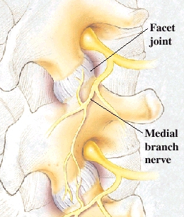
Facet Injuries
Main pain generators
Posterior column of the spine
Need NORMAL motion and mechanics to stay healthy
Innervated by medial branch which also innervates motor component of multifidus
Scleratogenous pain patterns

Slide 20
Facet injuries in MVC
Panjabi, M.M., et al., Capsular ligament stretches during in vitro whiplash simulations. J spinal disord, 1998. 11(3): p. 227-32
Head-Turned Postures Increase the Risk of Cervical Facet Capsule Injury During Whiplash. Spine. 33(15):1643-1649, July 1, 2008. Siegmund, Gunter P. PhD *+; Davis, Martin B. MS ++; Quinn, Kyle P. BS [S]; Hines, Elizabeth [S]; Myers, Barry S. PhD [P]; Ejima, Susumu PhD [//]; Ono, Kishiri PhD [//]; Kamiji, Koichi BS **; Yasuki, Tsuyoshi MS **; Winkelstein, Beth A. PhD
https://professionallyintegrated.com/category/diagnosis/facets/

Slide 21
Instability( M24.80)
“The loss of the ability of the spine under physiologic loads to maintain relationships between vertebrae in such a way that there is neither damage nor subsequent irritation to the spinal cord or nerve roots, and, in addition, there is no development of incapacitating deformity or pain due to structural changes.”
White AA, Panjabi MM: The problem of clinical instability in the human spine: a systematic approach. In: White AA, Panjabi MM, eds. Clinical Biomechanics of the Spine. 1978:192

Slide 22
Ligaments
Hold bones together
Gives proprioceptive information (Joint position sense)
Abnormal stress causes deformation
Do not heal to 100% resolution
What happens with a torn ACL…
Document with Posture Ray

Slide 23
Clinical signs of ligament injury
Pain
More pain with movement
Jarring motions irritate patients symptoms
Pain gets worse as day goes on
Pain is worse with movement
Nausea/dizziness with movement

Slide 24
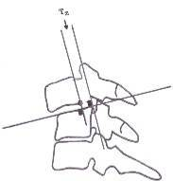
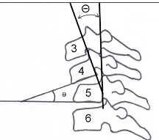
Measuring instability
Accepted movement of one bone to another
Lateral cervical translation= Max 3.5mm
Lateral curve angulations =max 11 degrees
C1 on C2 lateral translation=max 2mm (Research for all)
Must measure it
1A
1B

Slide 25
Ligament injuries and healing
“While ligaments are predominantly known as stabilizing agents in the joints, they also have an equally important role as sensory organs involved in ligamento-muscular reflexes.”
“In fact, evidence suggests that the injured ligament structure is replaced with tissue that is grossly, histologically, biochemically, and biomechanically similar to scar tissue.”
“Hypermobility and ligament laxity have become clear risk factors for the prevalence of OA . The results of spinal ligament injury show that over time the inability of the ligaments to heal causes an increase in the degeneration of disc and facet joints, which eventually leads to osteochondral degeneration”
The Open Rehabilitation Journal, 2013, 2013 Bentham Open Open Access Ligament Injury and Healing: A Review of Current Clinical Diagnostics and Therapeutics R.A. Hauser*
https://professionallyintegrated.com/diagnosis/instability/ligament-injury-healing-treatment-and-imaging/

Slide 26
https://professionallyintegrated.com/diagnosis/instability/dmx-loss-of-curve-and-instability/

Slide 27
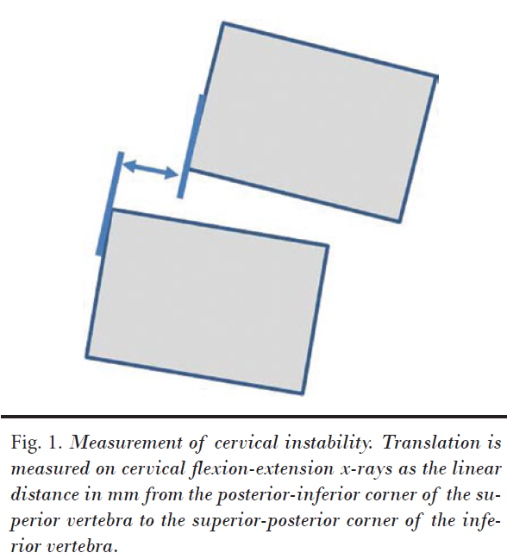
MVC and instability

Slide 28
CTE
for diagnosis of a Chiari Type I malformation is most frequently given as magnetic resonance imaging (MRI) evidence of low cerebellar tonsils relative to the foramen magnum
Other authors have suggested that the range of normal tonsil position ends at 2 mm below the basion-opisthion line (B-OL)
The term tonsillar ‘ectopia’ is used to characterize any condition in which the cerebellar tonsils are found to be below the B-OL, regardless of symptom presence

Slide 29
TMD
Jaw signs were defined as follows
Painful mouth opening or closing (yes or no).
Asymmetrical jaw movement, meaning visible
deviation from the vertical line between the incisors of the upper and lower jaw of more than 2 mm on mouth opening or closing (yes or no) was seen.
Reduced mouth opening, meaning that the distal interphalangeal joints of the subject’s fingers 2, 3 and 4 could not be inserted on each other between the front teeth (yes or no). The subject was considered to have jaw signs if one or more of these signs were present …

Slide 30
“In the present study, we found that individuals with a recent whiplash trauma reported more pain and disability in both the neck and jaw regions compared with controls without a history of neck trauma.”
“The main finding of the present study was that individuals with a recent whiplash trauma more often reported frequent jaw pain and disability compared with controls without a history of neck trauma. Furthermore, there was a positive correlation between the intensity of jaw pain and neck pain.”
Journal of Dental Research Pain and Disability in the Jaw and Neck Region following Whiplash Trauma B. Häggman-Henrikson ( Birgitta is coming to present at ATMI)

Slide 31
Patient report
Consult
Initial Evaluation/Exam
Initial Report
Soaps
Narratives

Slide 32
Can you stand by your notes??
Where?
Where?

Slide 33
ROM Example
Right lateral flexion : decreased 25% and tense and pain on the left over facets
Right rotation : decreased 25% and tense and pain on the left over facets with sclaratogenous pain into right scapula med scapula
Left rotation: decreased 25% and tense and pain on the left over facets
Not just decreased and pain!

Slide 34
https://professionallyintegrated.com/

